Slide 1

Capstone Project
Play Store App Review Analysis
By
Abhishek Rai
Data Science Trainee, AlmaBetter

Slide 2
PROBLEM STATEMENT
Two datasets are provided, one with basic information and the other with user reviews for the respective app.
We must examine and evaluate the data in both datasets in order to identify the important characteristics that influence app engagement and success.
BUSINESS CONTEXT
An app is said to be successful if it has:
A high average user rating
A good number of positive reviews
A good number of monthly average reviews
High revenue per customer and so on

Slide 3
DATA UNDERSTANDING
Play_Store_Data
App
Category
Size
Rating
Reviews
Installs
Type
User_reviews
App
Translated Review
Sentiment
Sentiment_Polarity
Sentiment_Subjectivity
Price
Content Rating
Genres
Last Updated
Current Ver
Android Ver
Rating Group
Revenue

Slide 4
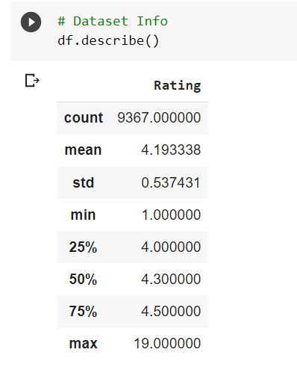
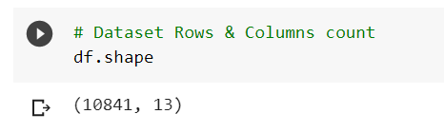
DATA LOADING
In this project, I have imported various libraries like numpy for numerical calculations, pandas for analysis on structured data, seaborn for exploratory data analysis, matplotlib for 2D plots of array and interactive visualizations.
I take statistical details about dataset using df.describe() and df.shape().

Slide 5
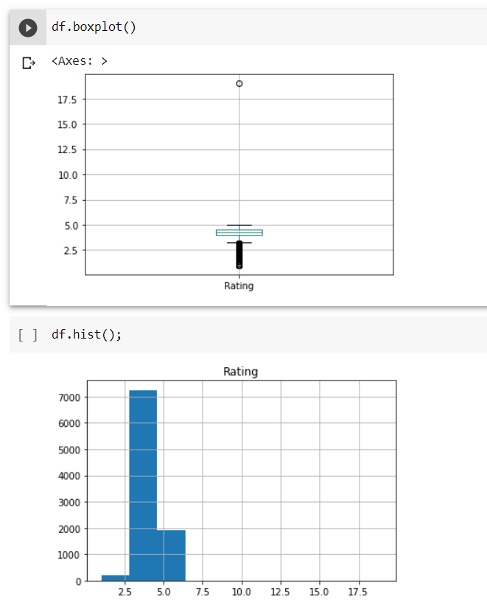
I have taken the boxplot and histogram of Dataframe.

Slide 6
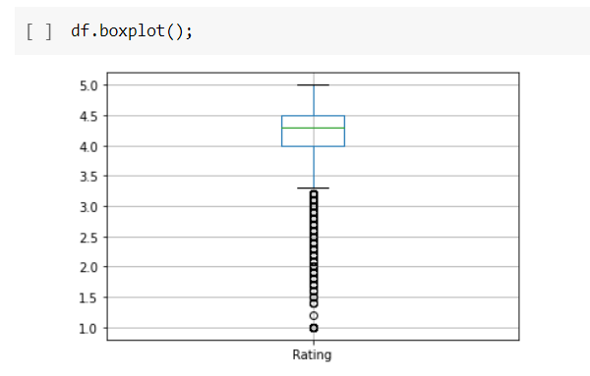
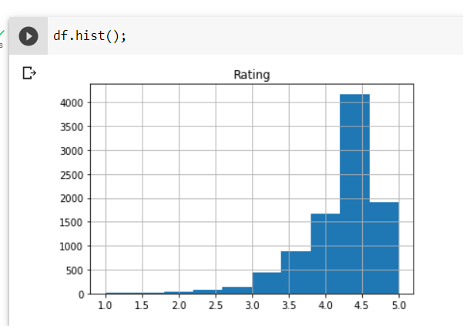
DATA CLEANING
In Data Cleaning, firstly we take out the information about the dataset using df.info().
Now, I will calculate the total null values in each column of dataset.
I will check how many outliers are there by knowing how many ratings greater than 5 using df[df.Rating > 5].
After that, I will drop that particular column which has rating greater than 5 and thus, the dataset will be free of any outliers which you can see in the boxplot and updated histogram below.

Slide 7
Now, I will remove the columns that are 90% empty because I don’t need those columns as there is no use of 10% data in a column
I make a variable ‘threshold’ in which I take length of dataframe and then I multiply it with 0.1 so that it will take 10% of the rows count using threshold = len(df) * 0.1.
I will remove those columns using df.dropna(thresh = threshold, axis = 1, inplace = True).

Slide 8
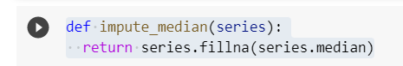
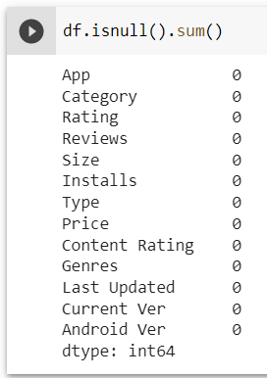
DATA MANIPULATION
I make a function named ‘impute_median’ and then I filled the series column with median.
Now I transform rating column by filling the null values in it with median using:- df.Rating = df['Rating'].transform(impute_median)
I fill the dataframe of column name ‘Type’ with the mode values using:- df['Type'].fillna(str(df['Type'].mode().values[0]),inplace=True)
Similarly do it for column name ‘Current Ver’ and ‘Android Ver’.
Now, there are no null values in any column:-

Slide 9
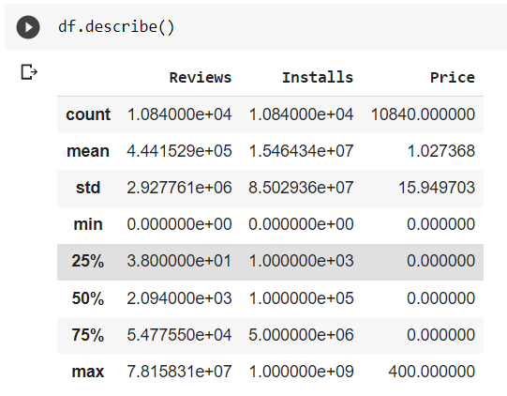
In price column, every ‘$’ is replaced with no space if ‘$’ present in str(x) using df['Price'] = df['Price'].apply(lambda x : str(x).replace('$','') if '$' in str(x) else str(x))
Convert the ‘Reviews’ column to numeric type using:- df['Reviews'] = pd.to_numeric(df['Reviews'],errors='coerce’) # errors = ‘coerce’ imply that it will replace all non-numeric values with NaN.
Similarly in ‘Installs’ column, every ‘+’ and ‘,’ is replaced with no space if ‘+’ and ‘,’ present in str(x) using:-df['Installs'] = df['Installs'].apply(lambda x : str(x).replace('+','') if '+' in str(x) else str(x)) df['Installs'] = df['Installs'].apply(lambda x : str(x).replace(',','') if ',' in str(x) else str(x))
To have all values in ‘Price’ and ‘Installs’ column as float values using:-df['Price'] = df['Price'].apply(lambda x : float(x)) df['Installs'] = df['Installs'].apply(lambda x : float(x))
Now ‘Reviews’, ‘Installs’ and ‘Price’ columns are all converted into numerical values which can be seen using df.describe():-

Slide 10
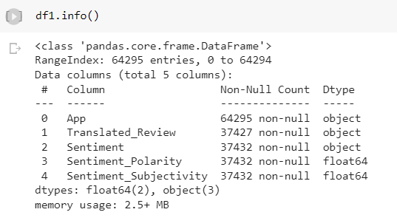
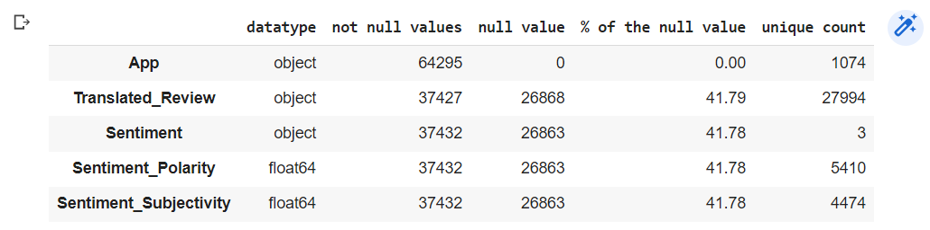
EXPLORING USER REVIEW DATA
Importing User_Review.csv file and then knowing the information about the dataset.
Making function Urinfo() for defining some specific parameters like null values, not null values, unique count, datatype, etc.

Slide 11
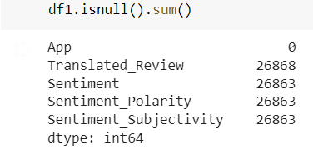
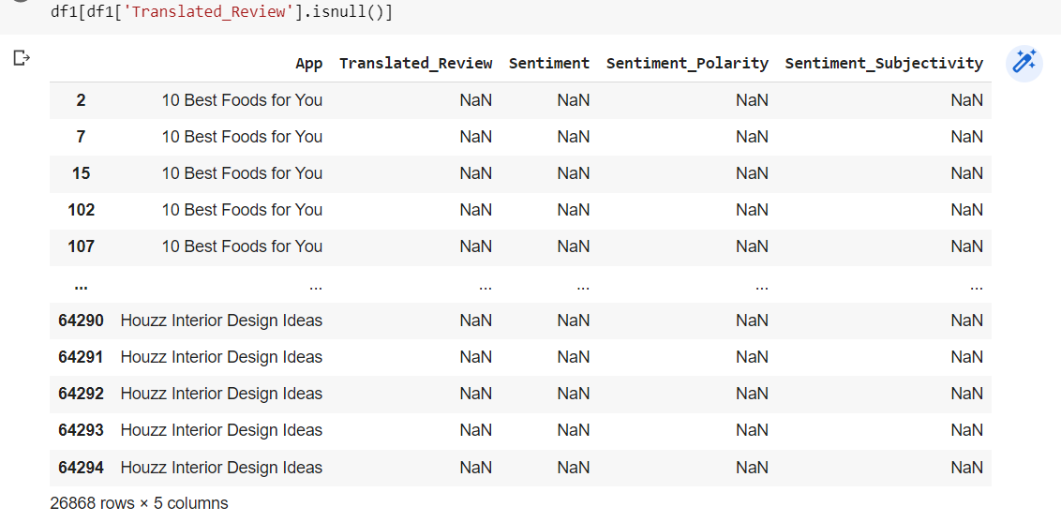
Finding the total number of NaN values in each column
The rows corresponding to the NaN values in the translated_review column, where the rest of the columns are non null.

Slide 12
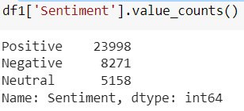
Deleting the rows containing NaN values
Inspecting the sentiment column

Slide 13
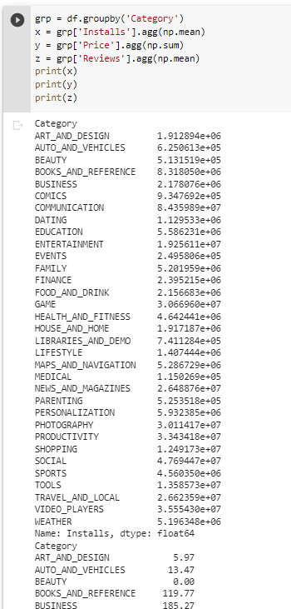
DATA VISUALIZATION FOR PLAY STORE DATA
I have grouped the data based on ‘Category’ column using grp=df.groupby(‘Category’).
I have taken three variables x,y and z. In variable x, I find mean of each category in ‘Installs’ column using x=grp[‘Installs’].agg(np.mean). Similarly in variable z, I find mean of each category in ‘Reviews’ column. In variable y, I find sum of each category in ‘Price’ column using x=grp[‘Price’].agg(np.sum).

Slide 14
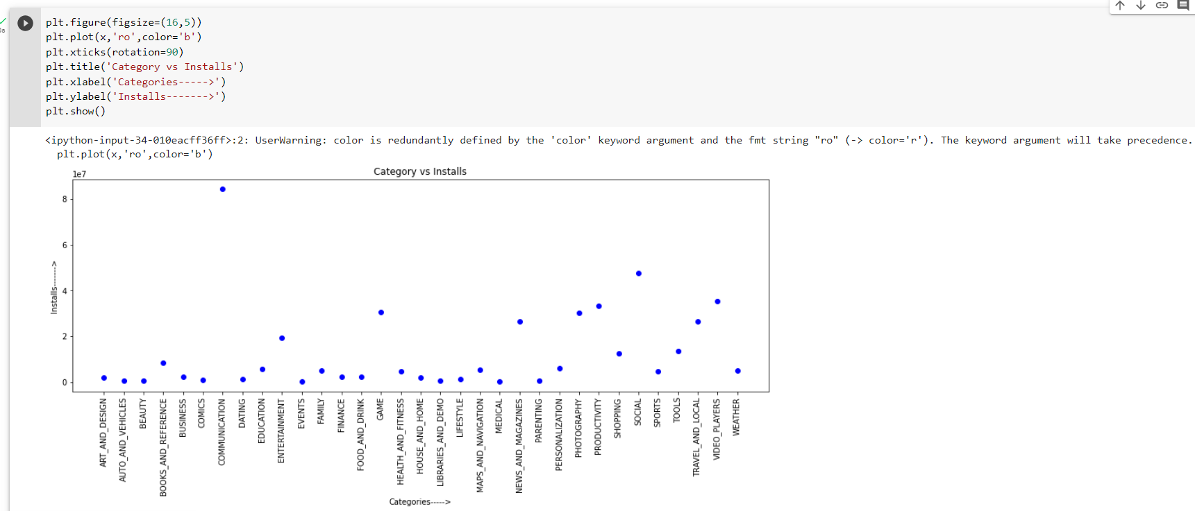
Plotting x(‘Category vs Installs’) with figure size of width:16 and height:5 and figure plotting with blue round circles. Find figure below:-

Slide 15
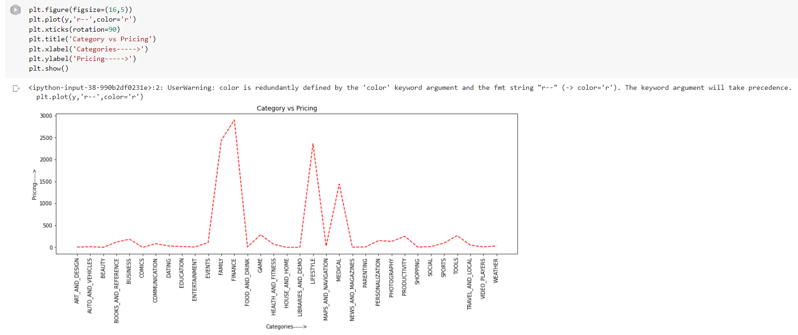
Plotting y(‘Category vs Pricing’) with figure size of width:16 and height:5 and figure plotting with red dashed lines. Find figure below:-

Slide 16
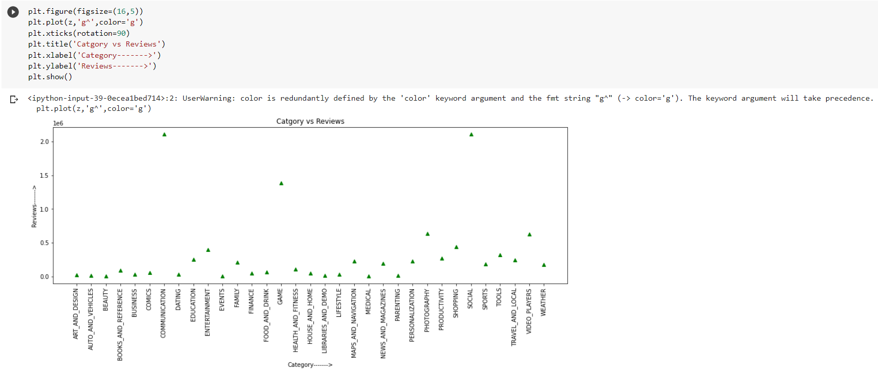
Plotting z(‘Category vs Reviews’) with figure size of width:16 and height:5 and figure plotting with green triangle-up markers. Find figure below:-

Slide 17
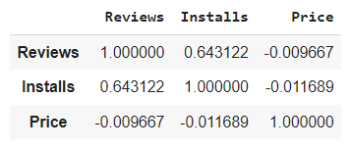
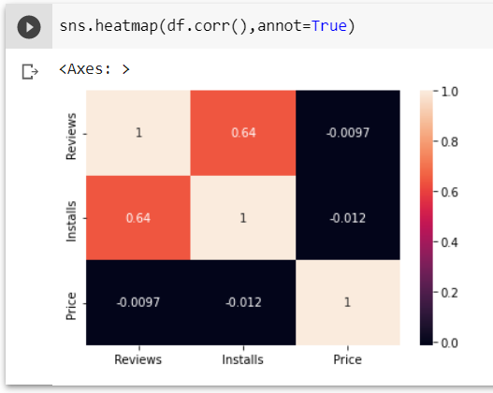
I have found the correlation among different columns(Reviews,Installs,Price) using df.corr().
I have also made the seaborn heatmap of df.corr() with data values in each cell using:- sns.heatmap(df.corr(),annot=True)

Slide 18
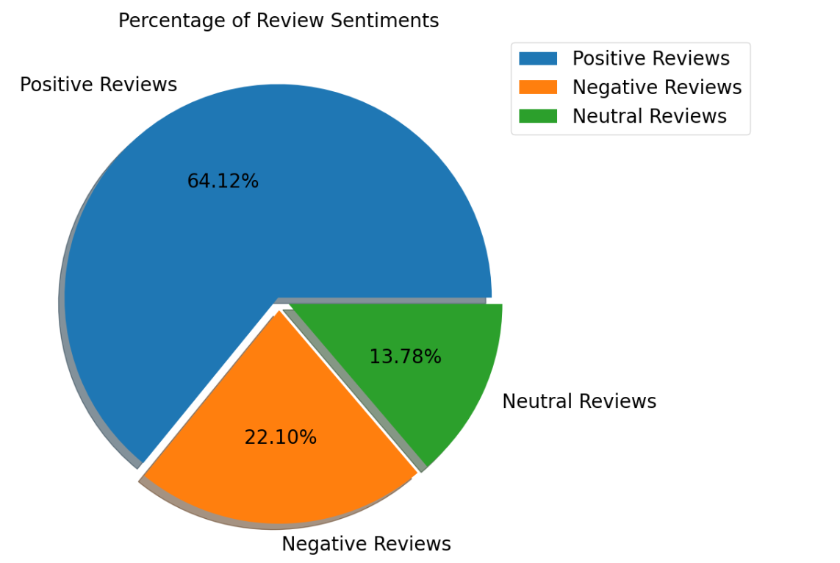
DATA VISUALIZATION FOR USER REVIEW DATA
I have shown the percentage of review sentiments in form of pie chart by bifurcating positive, negative and neutral sentiments.

Slide 19
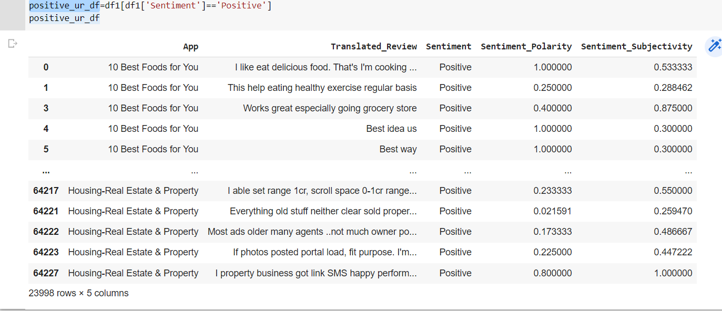
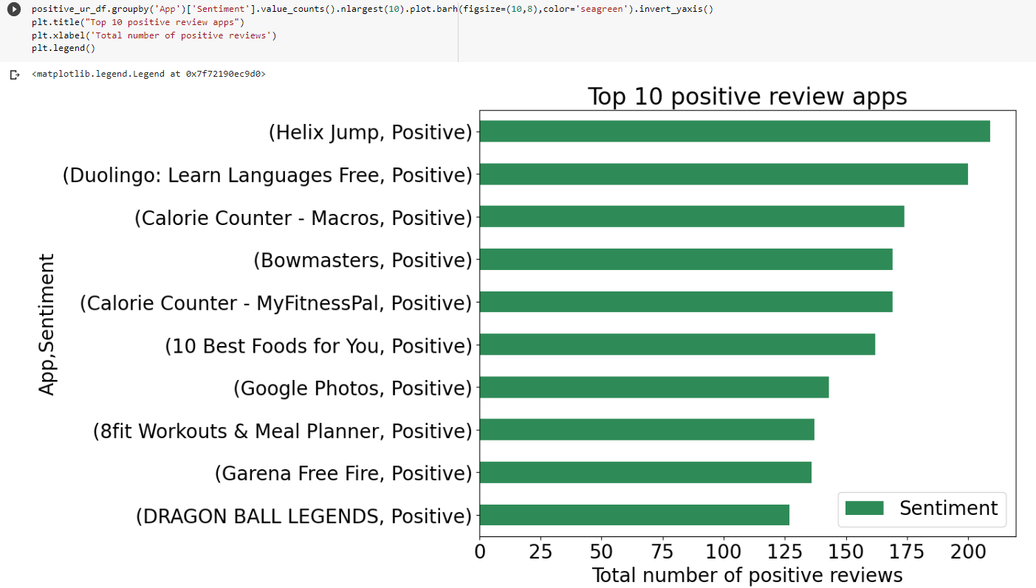
I have now assigned the positive reviews in positive_ur_df from Sentiment column.
I have shown the bar chart of top 10 positive reviews in the form of bar chart.

Slide 20
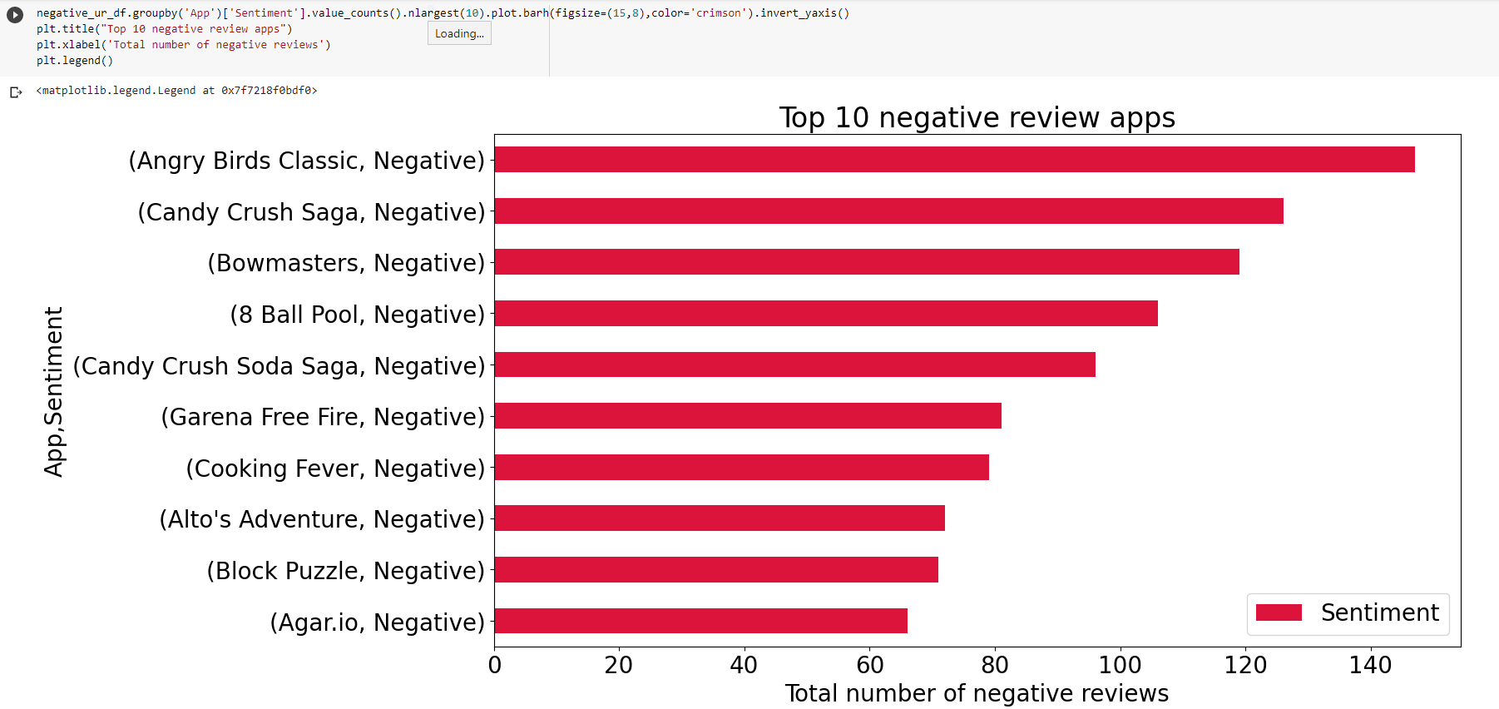
Similarly, plotted bar plot for the negative reviews.

Slide 21
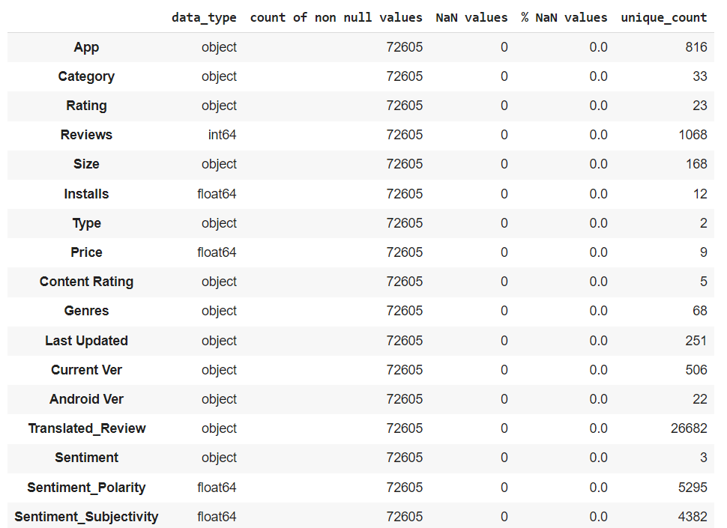
I have created a merged dataframe combining both the Play_Store and User_Review dataframe.
Making function merged_dfinfo() for defining some specific parameters like null values, not null values, unique count, datatype, etc.

Slide 22
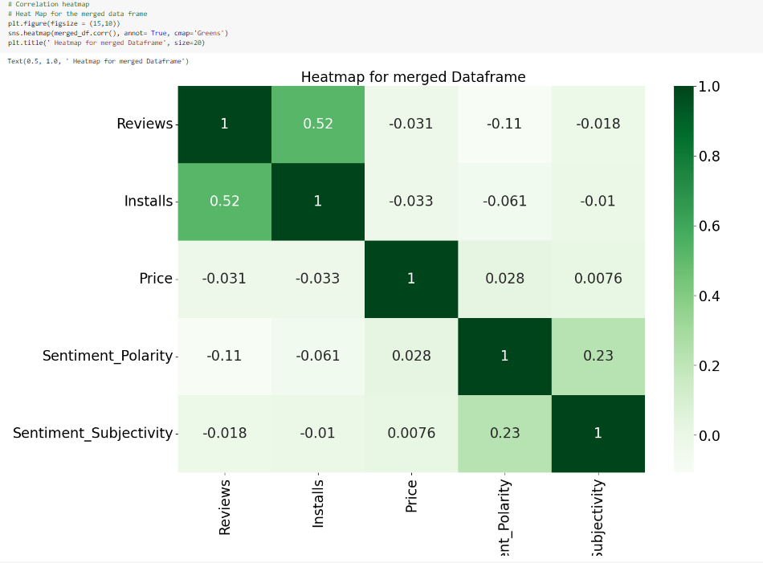
I have made the heatmap for the merged dataframe correlation.

Slide 23
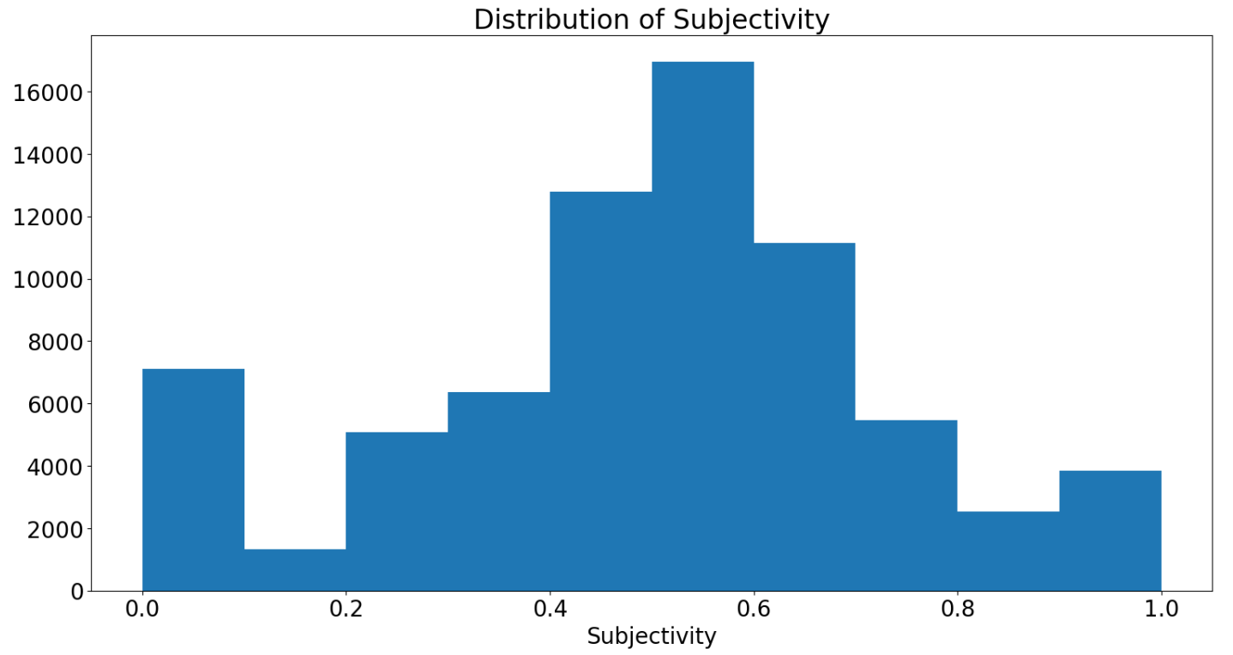
It can be seen that maximum number of sentiment subjectivity lies between 0.4 to 0.7. From this we can conclude that maximum number of users give reviews to the applications, according to their experience.

Slide 24
CONCLUSION
The highest number of installs are in the Communication category with around 8.4x10^(7) installs.
The highest sum of pricing is in the Finance category followed by Family category.
The highest number of reviews are in the Communication category followed by Social and Game categories.
Most installed apps are also rated between mostly 4 and 4.5. All active apps on play store have an average rating of 4.32.
From installs, price, reviews co-relation graph, we found installs and reviews are positively co-related means when installation is more reviews are more, and when it lacks, reviews are less.
The dataset is now free of all the null values and outliers.
Overall sentiment count of merged dataset in which Positive sentiment count is 64%, Negative 22% and Neutral 14%.
Price, Rating, Size has no or very less correlation with Sentiment Polarity.
Helix Jump has the highest number of positive reviews and Angry Birds Classic has the highest number of negative reviews.

Slide 25


